Slide 1
Hierarchical Clustering FAI-UNIT-V

Slide 2
Introduction:
The agglomerative hierarchical clustering algorithm is a popular example of HCA.
To group the datasets into clusters, it follows the bottom-up approach. It means, this algorithm considers each dataset as a single cluster at the beginning, and then start combining the closest pair of clusters together. It does this until all the clusters are merged into a single cluster that contains all the datasets.
This hierarchy of clusters is represented in the form of the dendrogram.

Slide 3
Hierarchical Clustering
Hierarchical Methods
This method creates a hierarchical decomposition of the given set of data objects. We can classify hierarchical methods on the basis of how the hierarchical decomposition is formed. There are two approaches here −
Agglomerative Approach
Divisive Approach
Agglomerative Approach
This approach is also known as the bottom-up approach. In this, we start with each object forming a separate group. It keeps on merging the objects or groups that are close to one another. It keep on doing so until all of the groups are merged into one or until the termination condition holds.
Divisive Approach
This approach is also known as the top-down approach. In this, we start with all of the objects in the same cluster. In the continuous iteration, a cluster is split up into smaller clusters. It is down until each object in one cluster or the termination condition holds. This method is rigid, i.e., once a merging or splitting is done, it can never be undone.

Slide 4
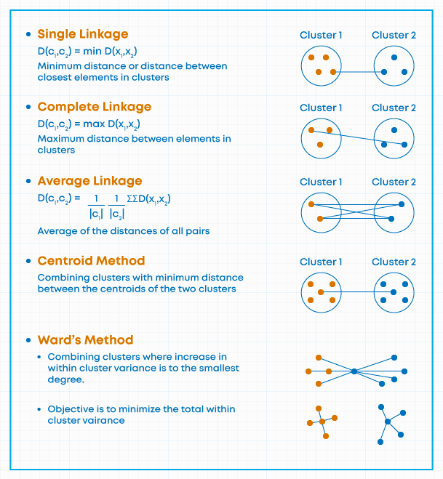
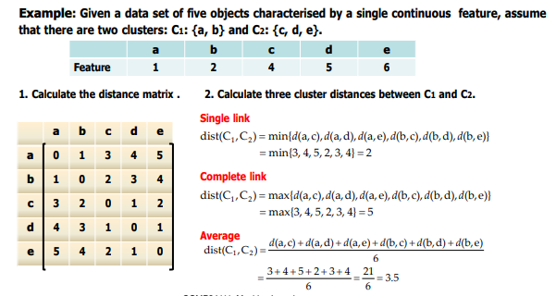
Distance measures

Slide 5
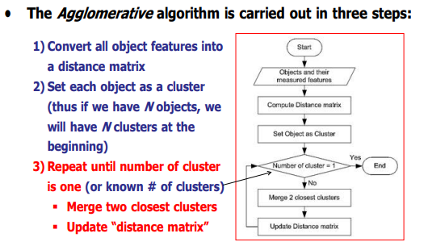
Agglomerative Algorithm

Slide 6
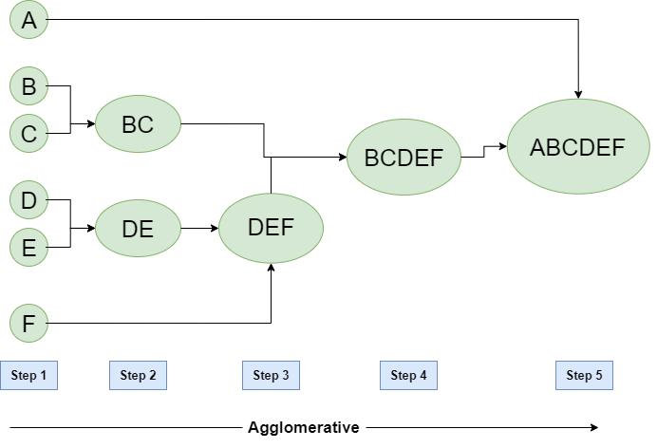
Agglomerative Approach
Agglomerative Clustering is a bottom-up approach, initially, each data point is a cluster of its own, further pairs of clusters are merged as one moves up the hierarchy.
Steps of Agglomerative Clustering:
Initially, all the data-points are a cluster of its own.
Take two nearest clusters and join them to form one single cluster.
Proceed recursively step 2 until you obtain the desired number of clusters.
Example 1:
Let’s say we have six data points A, B, C, D, E, F.

Slide 7
Step-1: Consider each alphabet as a single cluster and calculate the distance of one cluster from all the other clusters.
Step-2: In the second step comparable clusters are merged together to form a single cluster. Let’s say cluster (B) and cluster (C) are very similar to each other therefore we merge them in the second step similarly with cluster (D) and (E) and at last, we get the clusters [(A), (BC), (DE), (F)]
Step-3: We recalculate the proximity according to the algorithm and merge the two nearest clusters([(DE), (F)]) together to form new clusters as [(A), (BC), (DEF)]
Step-4: Repeating the same process; The clusters DEF and BC are comparable and merged together to form a new cluster. We’re now left with clusters [(A), (BCDEF)].
Step-5: At last the two remaining clusters are merged together to form a single cluster [(ABCDEF)].

Slide 8
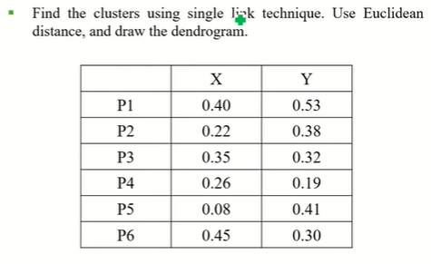
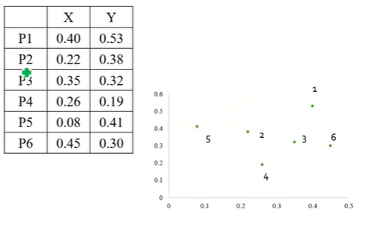
Example:

Slide 9
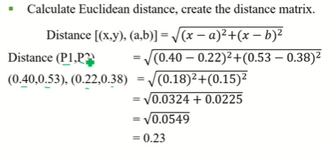
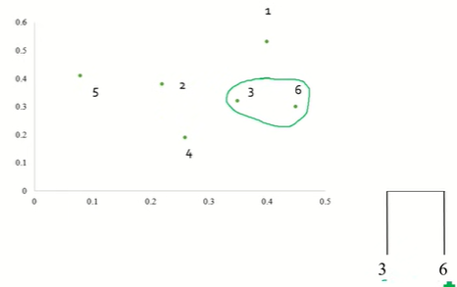
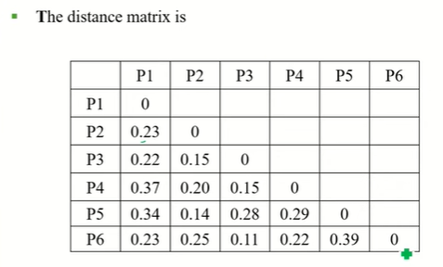

Slide 10
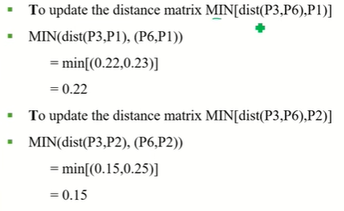
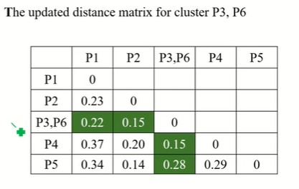
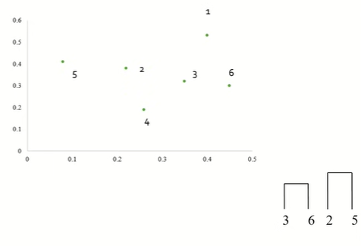
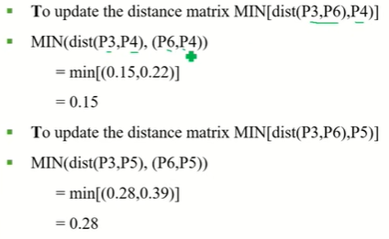

Slide 11
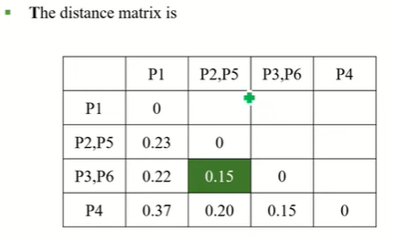
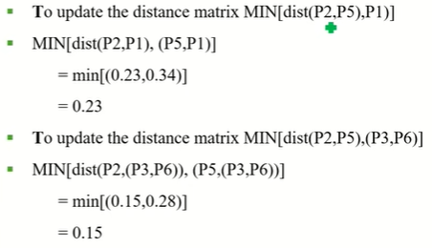
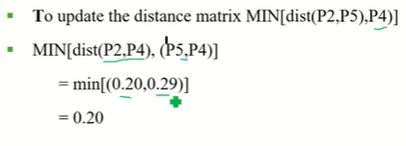
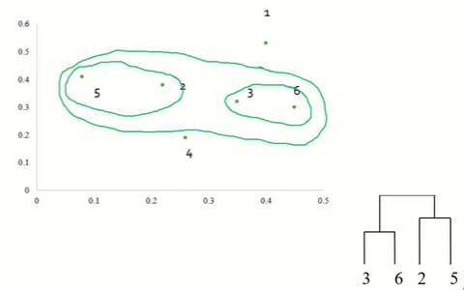

Slide 12
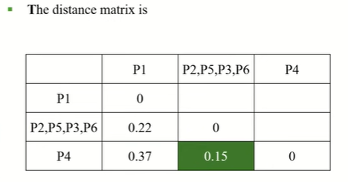
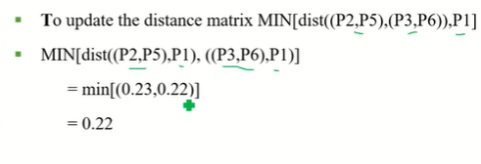
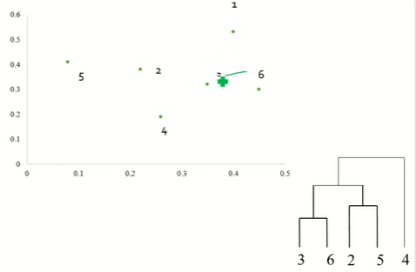
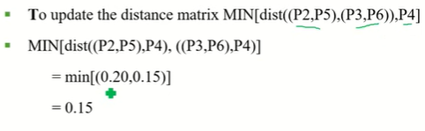

Slide 13
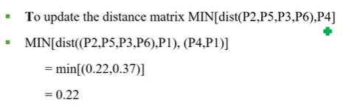
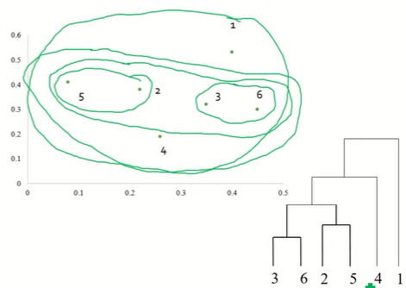
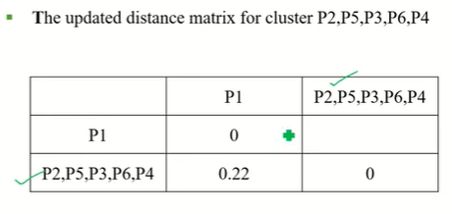

Slide 14
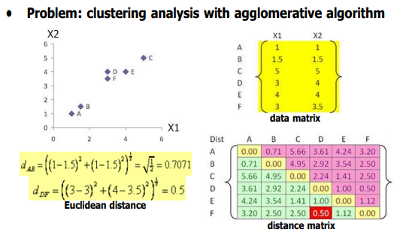
Agglomerative Algorithm

Slide 15
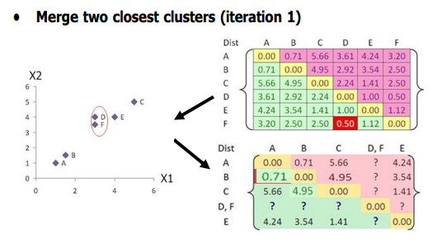

Slide 16
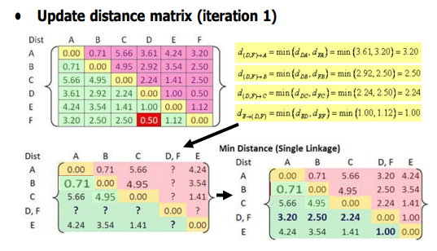

Slide 17
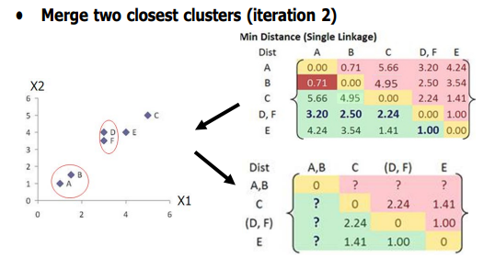

Slide 18
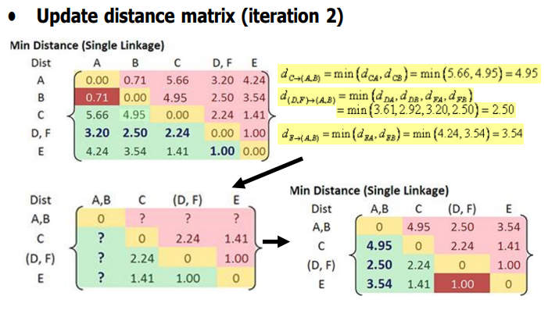

Slide 19
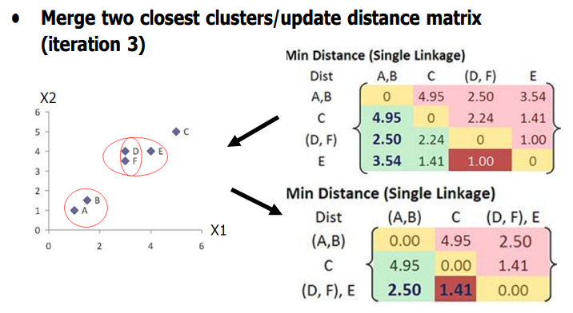

Slide 20
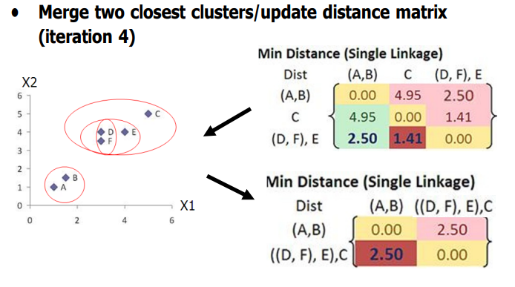

Slide 21
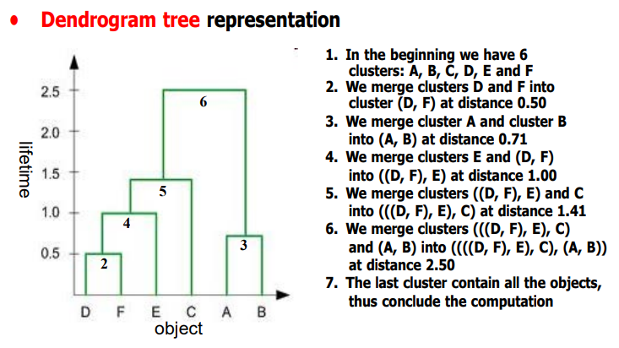

Slide 22
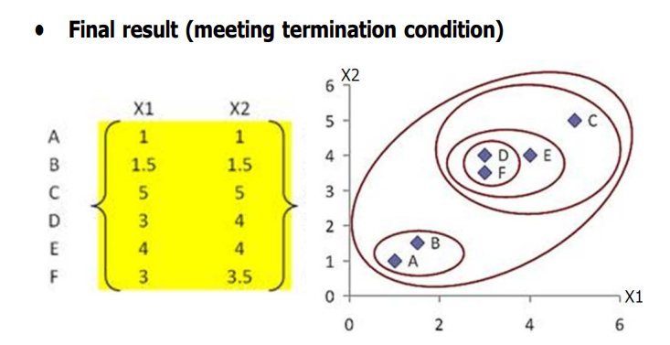

Slide 23
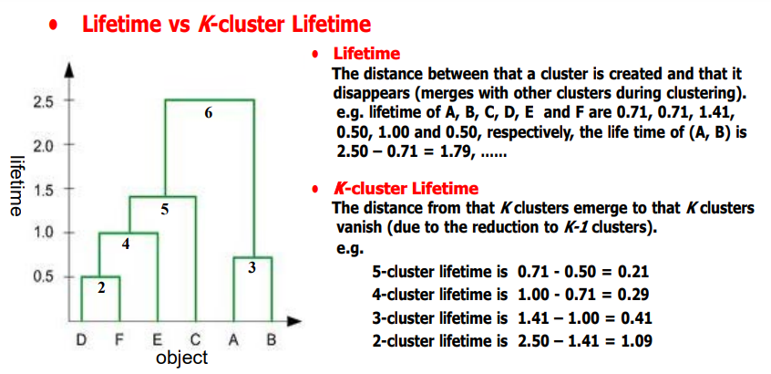

Slide 24
Divisive Clustering:
The divisive clustering algorithm is a top-down clustering approach, initially, all the points in the dataset belong to one cluster and split is performed recursively as one moves down the hierarchy.
Steps of Divisive Clustering:
Initially, all points in the dataset belong to one single cluster.
Partition the cluster into two least similar cluster
Proceed recursively to form new clusters until the desired number of clusters is obtained.
Example 1:
We can say that the Divisive Hierarchical clustering is precisely the opposite of the Agglomerative Hierarchical clustering. In Divisive Hierarchical clustering, we take into account all of the data points as a single cluster and in every iteration, we separate the data points from the clusters which aren’t comparable. In the end, we are left with N clusters.

Slide 25
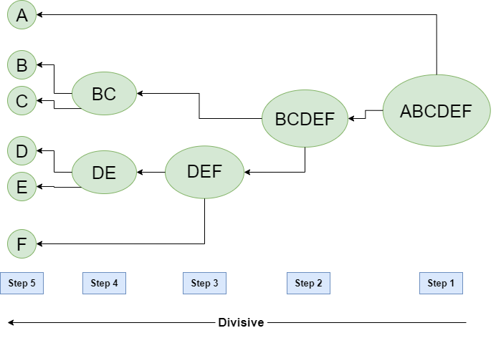
Figure – Divisive Hierarchical clustering

Slide 26
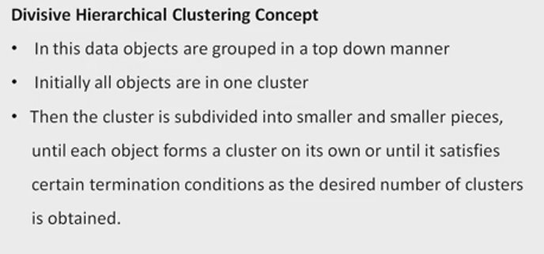
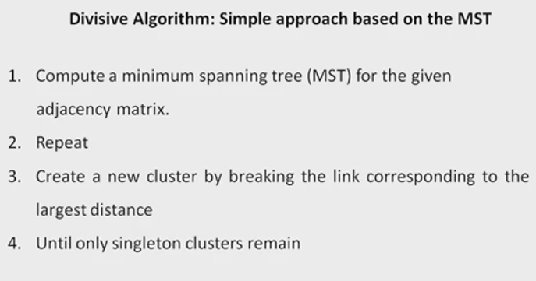
Divisive Algorithm using Minimum Spanning Tree

Slide 27
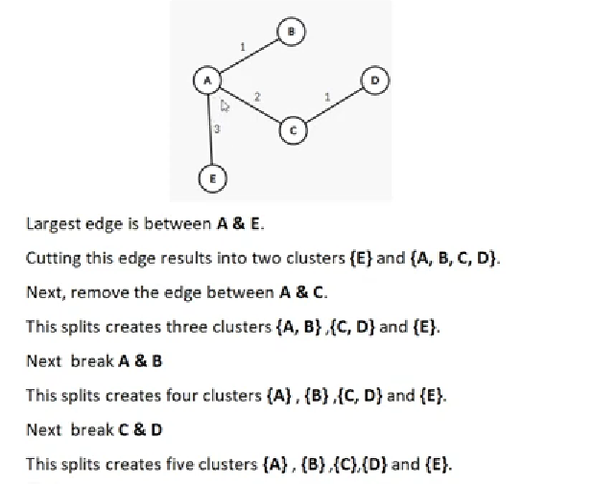
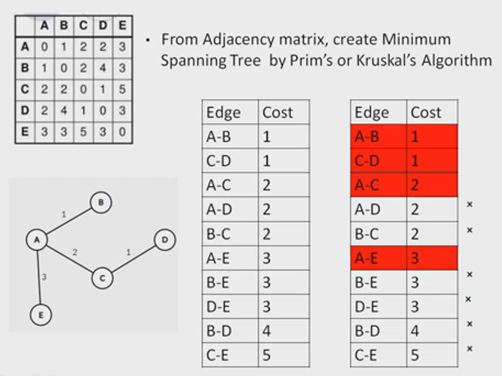
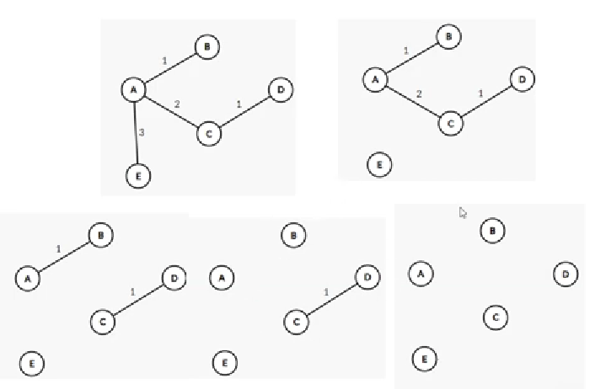
Example 1

Slide 28
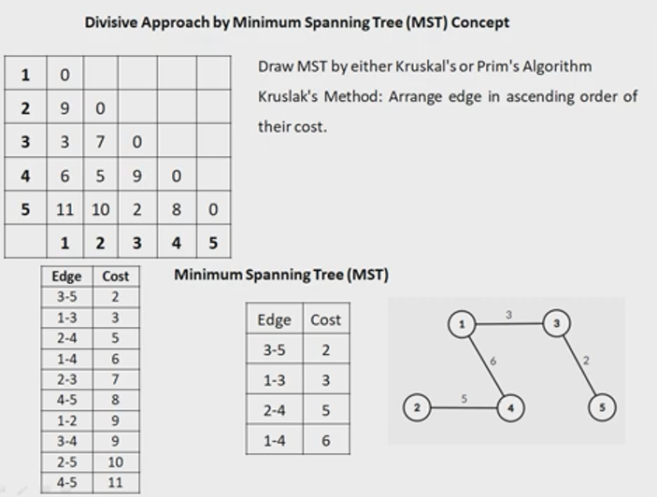
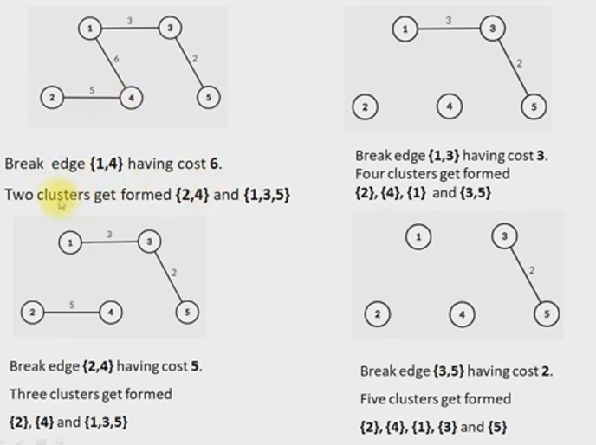
Example 2

Slide 29
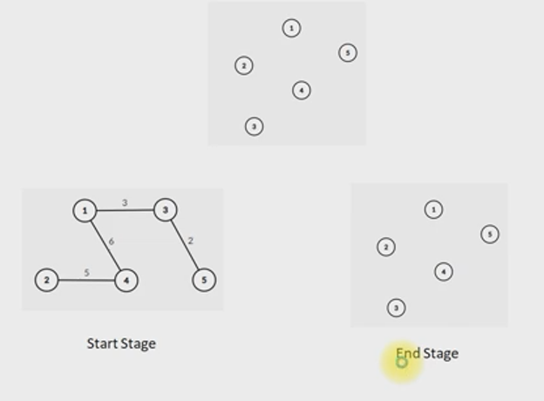

Slide 30
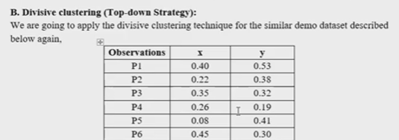
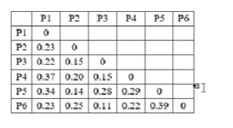
Example 3

